Slide 1


Stock Market Prediction
USING
MACHINE LEARNING
Akshay R 1ST14CS010
Aravind B 1ST14CS023
Arun Kumar 1ST14CS025
Ashok S 1ST14CS027
Under the guidance of
Dr. T John Peter
H.O.D, Dept. of CSE
Sambhram Institute of Technology
Department of Computer Science & Engineering

Slide 2

System Design
Data Flow Diagram
Sequence Diagram
Agenda
Architecture
Implementation
Screenshot
Conclusion

Slide 3
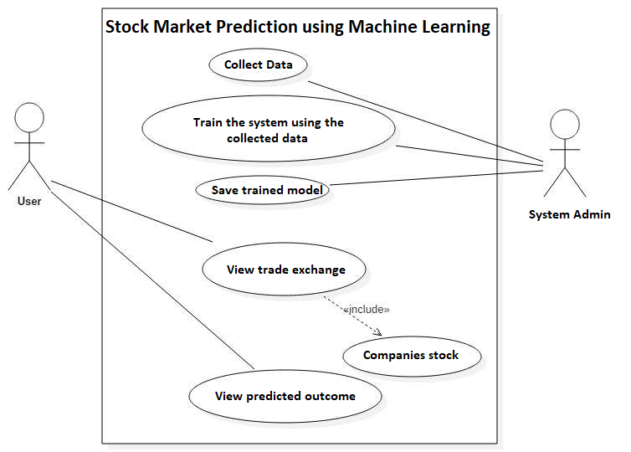
System Design
USE CASE DIAGRAM
Data is initially collected from online sources or the stock exchange
The data is then used to train the system
Trained model is saved
User views the trade exchange and stock of a company
Using the model, closing prices are predicted

Slide 4
Data-Flow Diagram
Initialize Parameters
Select Training Set
Feature Scaling
Training Data
Firefly Algorithm
Optimal
Hyperparameters
LSSVR training model
Save Model

Slide 5
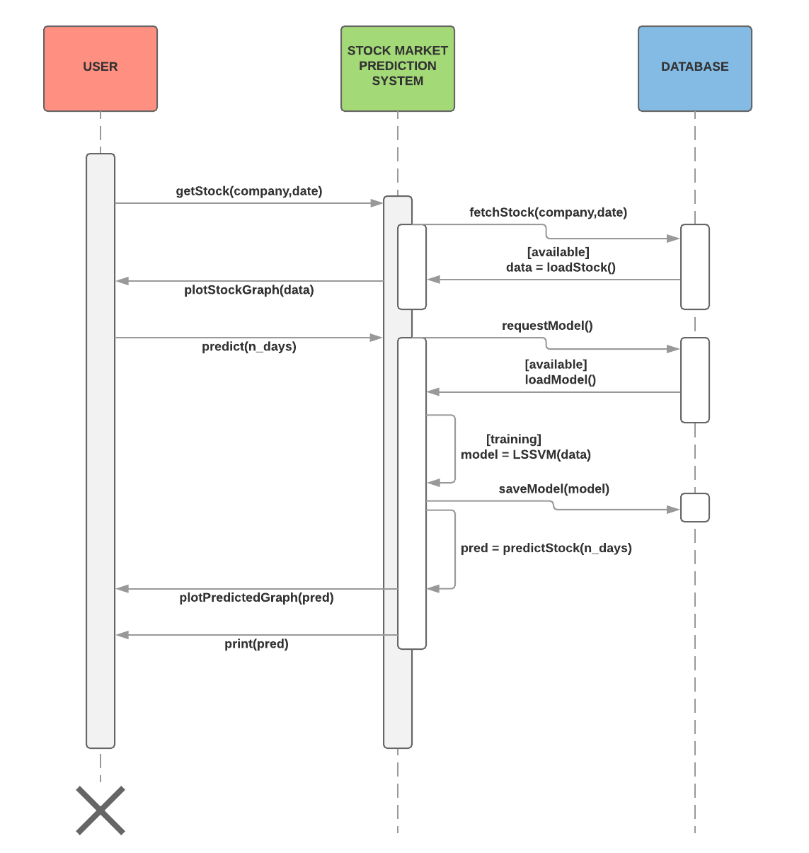
Sequence Diagram
SEQUENCE DIAGRAM
User visits the website/webapp
Previously saved model is loaded
User requests for a company's stock data
He requests for prediction to be made
The Stock Market Prediction System trains a model using the data from the database
The model is saved for further use and closing price is predicted
Result is displayed along with graph

Slide 6
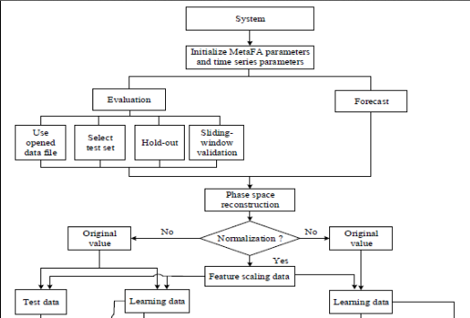
Architecture - 1

Slide 7
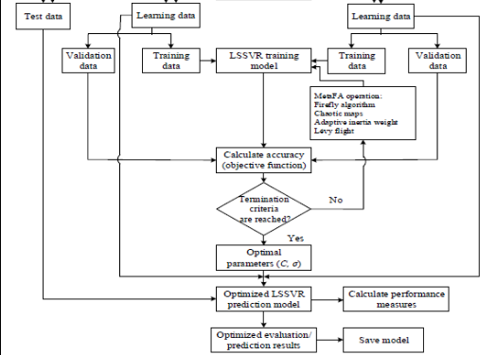
Architecture - 2

Slide 8


Implementation
Least Squares Support Vector Regression
The least squares version of the SVM classifier is obtained by reformulating the minimization problem as
For the kernel function K(•, •) one typically has the Radial Basis Function
The LSSVR algorithm is a further development of SVR by Suykens (2001) and involves equality instead of inequality constraints, and works with a least squares objective function. The LSSVR approach considerably reduces computational complexity and increases efficiency compared to standard SVM. LSSVR solves linear equations instead of a quadratic programming problem

Slide 9
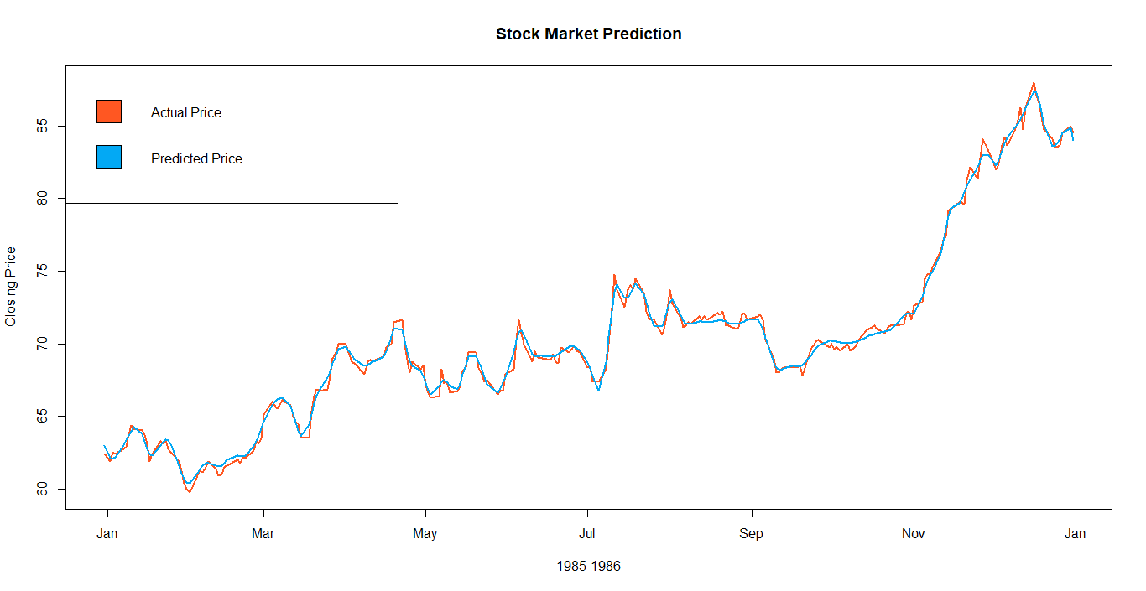
Screenshot

Slide 10

Conclusion
Thus, as we can see above in our proposed method, we train the data using the training data set at the beginning of the stock data. We use this data to predict and forecast the test and cross validation stock prices.
We should be able to show that the difference between the predicted value and the actual value of the closing price in the test dataset must be as minimum as possible

Slide 11
Thank You
Akshay R 1ST14CS010
Aravind B 1ST14CS023
Arun Kumar 1ST14CS025
Ashok S 1ST14CS027
Under the guidance of
Dr. T John Peter
H.O.D, Dept. of CSE

